Slide 1

Runtime classes
This section introduces you to the procedures for creating your own classes

Slide 2
Runtime classes
Creates a new class not defined in a runtime module
Requires a C/C++ compiler (Windows)
Both private C/C++ and public GridLAB-D properties allowed
Requires procedure definitions

Slide 3
General syntax
class classname [inheritance] {
// variables ...
GLMtype [options] property_name[[unit]];
// GridLAB-D procedures ...
intrinsic procedure (arguments) {
// ...
};
// other class members ...
public member ...;
protected member ...;
private member ...;
}

Slide 4
Variables
Default is to publish variable as property
  double frequency[Hz];
  GLM types are recognized in C/C++
  Other C/C++ types cannot be published
C/C++ types must have scope keyword, e.g.,
  private char[10] name;
Enumeration and set require keywords
  enumeration {OFF=0, ON=1} status;
  set {A=1, B=2, C=4, D=8} phases;
Date/time uses timestamp type
  timestamp lastchange;
my refers to current object, e.g., my->name

Slide 5
Create procedure
Always take object as argument
  Only set if parent is known at time of creation
Return value: SUCCESS or FAILED
Used to set object defaults
  intrinsic create(object parent) {
  // set defaults here
  return SUCCESS;
  };

Slide 6
Init procedure
Always takes object as argument
  Only set only if parent is defined
Return value: SUCCESS or FAILED
Used to validate and initialize object
  intrinsic init(object parent) {
  // check values here
  return SUCCESS;
  };

Slide 7
Presync/Sync/Postsync procedure
Always take 2 timestamp arguments
  t₀ is from time: < t₁ on first iteration; =t₁ otherwise
  t₁ is desired to time
Return value is timestamp t₂
  if t₂ < t₁ then sync failed: unable to continue
  if t₂ = t₁ then sync failed: another iteration needed
  if t₂ > t₁ then sync succeed
  t₂ = TS_NEVER means steady state
  Simulation runs until all t₂ are TS_NEVER
  t₂ < 0 means “soft” event (treated as TS_NEVER if no other events are “hard”, otherwise –t₂ is used)

Slide 8
Synchronization procedures
intrinsic sync(timestamp t0, timestamp t1)
{
timestamp t2 = TS_NEVER;
bool failed = false;
bool retry = false;
// perform sync operations
// set failed and retry as appropriate
return failed ? t0 : (retry ? t1 : t2);
};

Slide 9
Role of ranks
Objects of same rank can run simultaneously
Presync runs first
  Top-down: highest rank objects first
  Usually used to setup accumulators
Sync runs second
  Bottom-up: lowest rank objects first
  Primary calculations done in sync
Postsync runs last (also top-down)
  Usually used to finalize accumulators

Slide 10
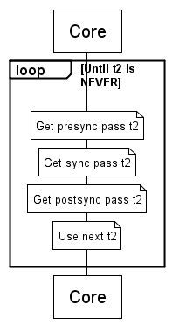
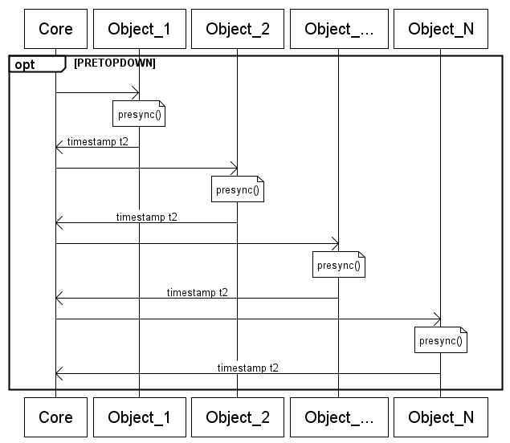
Presync pass sequence

Slide 11
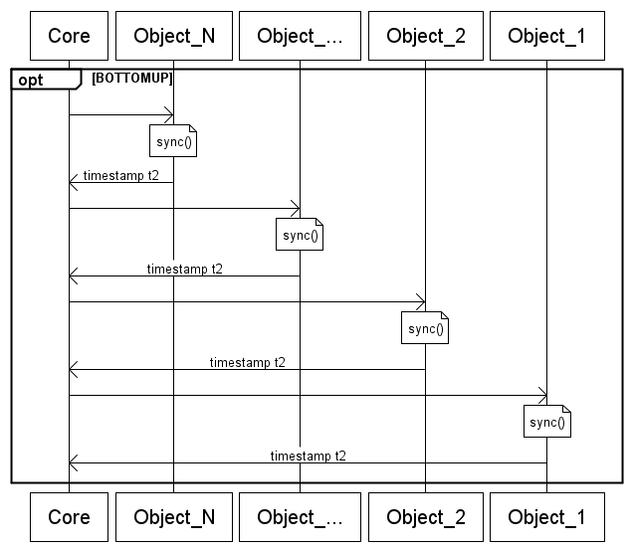
Sync pass sequence

Slide 12
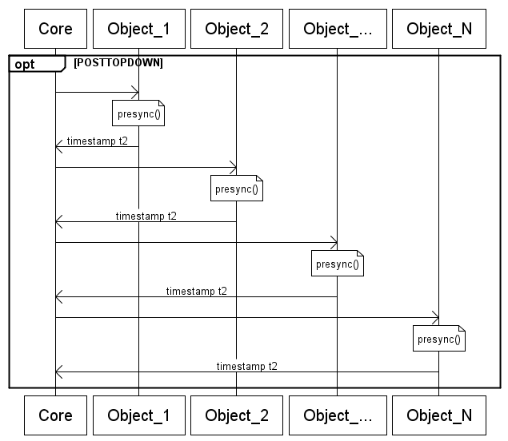
Postsync pass sequence

Slide 13
Understanding sync windows
Object 1
t₀
t₁
t₂
Object 2
t₀
t₁
t₂
Object 3
t₀
t₁
t₂
t₀ changes to t₁ after first iteration
Smallest t₂ is used for next time t₁

Slide 14
Runtime functions
All GridLAB-D functions use gl_ prefix
Major categories
  Output messages
  Time handling
  Module and class access
  Object and property access
  Random number and other utilities

Slide 15
Message output
Primary functions
gl_verbose
gl_output
gl_warning
gl_error
gl_debug
gl_testmsg
Related functions
gl_name
gl_strftime

Slide 16
General functions
Information access
gl_global_getvar
gl_set_parent
gl_get_value
gl_get_addr
gl_get_function
Simulation control
gl_throw
Random numbers
gl_random_*
Object creation
gl_create_object

Slide 17
Time handling
gl_timestamp
gl_seconds
gl_minutes
gl_hours
gl_days
gl_weeks
gl_globalclock
gl_localtime
gl_strftime

Slide 18
MODULE structure
typedef struct {
char name[1024]; // name of module
CLASS *oclass; // list of classes
unsigned short major; // major version number
unsigned short minor; // minor version number
PROPERTY *globals; // list of globals
} MODULE;

Slide 19
CLASS structure
typedef struct {
char name[64]; // class name
MODULE *module; // module that implement the class
PROPERTY *pmap; // list of properties
FUNCTION *fmap; // list of functions
CLASS *parent; // class parent
CLASS *next; // next class in list
} CLASS;

Slide 20
OBJECT structure
typedef struct {
unsigned int id; // id (unique)
CLASS *oclass; // class
object next; // next object in list
object parent; // parent unsigned
int rank; // rank
timestamp clock; // clock
double latitude, longitude; // geocoordinates
timestamp in_svc, out_svc; // service times
char *name; // name of object
} OBJECT;

Slide 21
PROPERTY structure
typedef struct {
char name[64]; // name
long ptype; // type (e.g., PT_bool)
unsigned long size; // array size
long access; // access (e.g., PA_PUBLIC)
UNIT *unit; // units if any, or NULL
void *addr; // header offset or global address
KEYWORD *keywords; // list of valid keywords
struct s_property_map *next; // next in list
PROPERTYFLAGS flags; // flags (e.g., PF_RECALC)
} PROPERTY;

Slide 22
FUNCTION structure
typedef struct {
char name[64]; // name of function
int64 (*addr)(void*, ...); // entry of function
FUNCTION *next; // next function in list
} FUNCTION;

Slide 23
UNIT structure
typedef struct {
char name[64]; // name of unit
double c,e,h,k,m,s,a,b; // unit parameters
int prec; // precision of unit
UNIT *next; // next unit in list
} UNIT;

Slide 24
Installing the compiler
Install the mingw compiler
  Download current mingw-win32.exe
  Install latest version into c:\mingw
  Don’t forget to select the g++ compiler option
Install the GridLAB-D runtime files
  Unzip rt.zip in C:\Program Files\GridLAB-D
  Check c:\program files\gridlab-d\rt\gridlabd.h

Slide 25
GLM settings
c:/temp is used for working files (must exist)
Must set paths in GLM file (can use .conf)
  #setenv PATH=c:/mingw/bin
  #define INCLUDE=c:/program files/gridlab-d
  Note: this is a bug—both should use #setenv
Some useful settings for troubleshooting
  #set debug=1
  allows you to see g++ commands
  #set verbose=1
  allows you to see working files

Slide 26
Help
Wiki search on “Runtime functions”

Slide 27
Exercises
Make a “hello world” object
Make a 10 second countdown object
How do several countdowns interact?
  Hint: use gl_debug to see object names
Make the start and timestep variables
  Try different starts and timesteps
How does synchronization work then?

